Slide 1

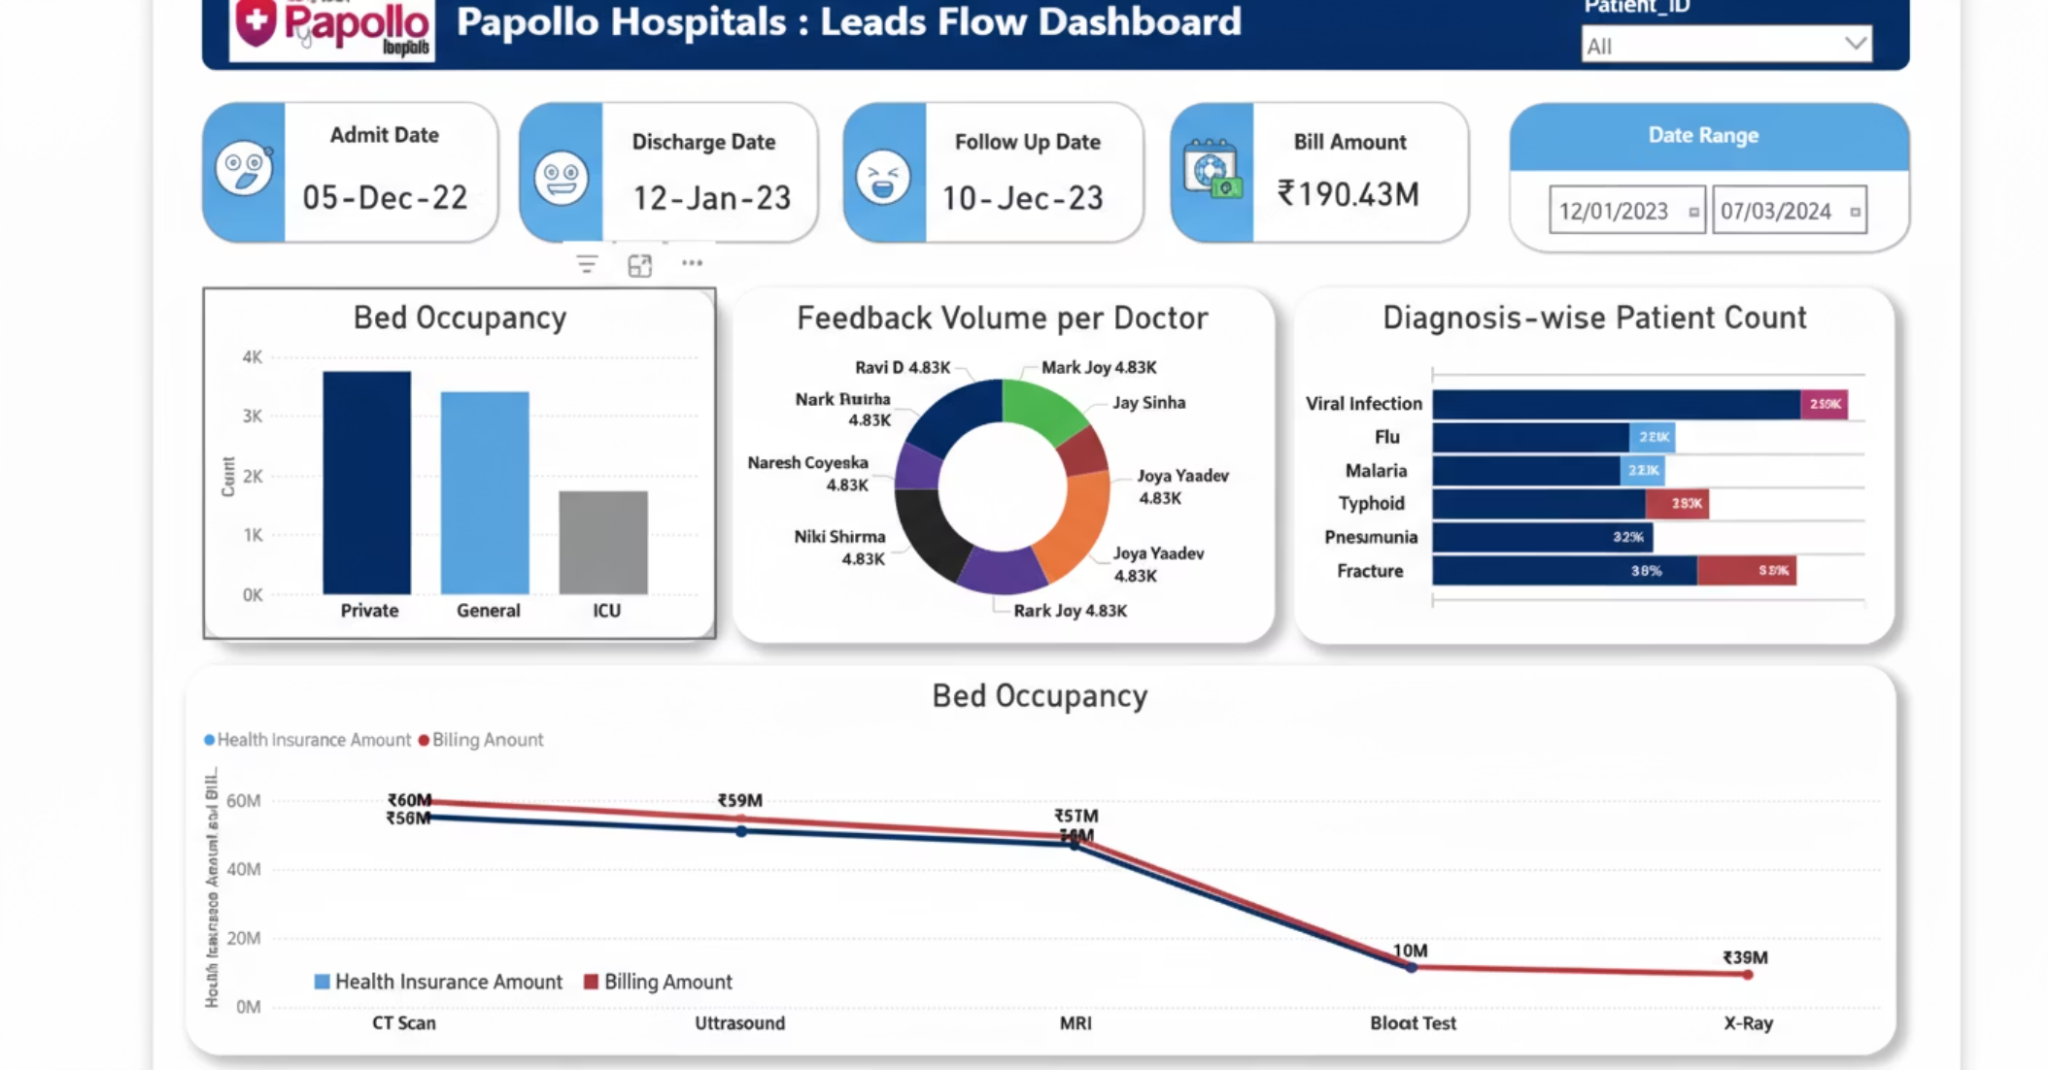
Hospital Patient Data Analysis
Interactive Dashboard for Clinical Intelligence
Transforming 168 patient records into actionable insights through comprehensive data visualisation and interactive analytics.

Slide 2
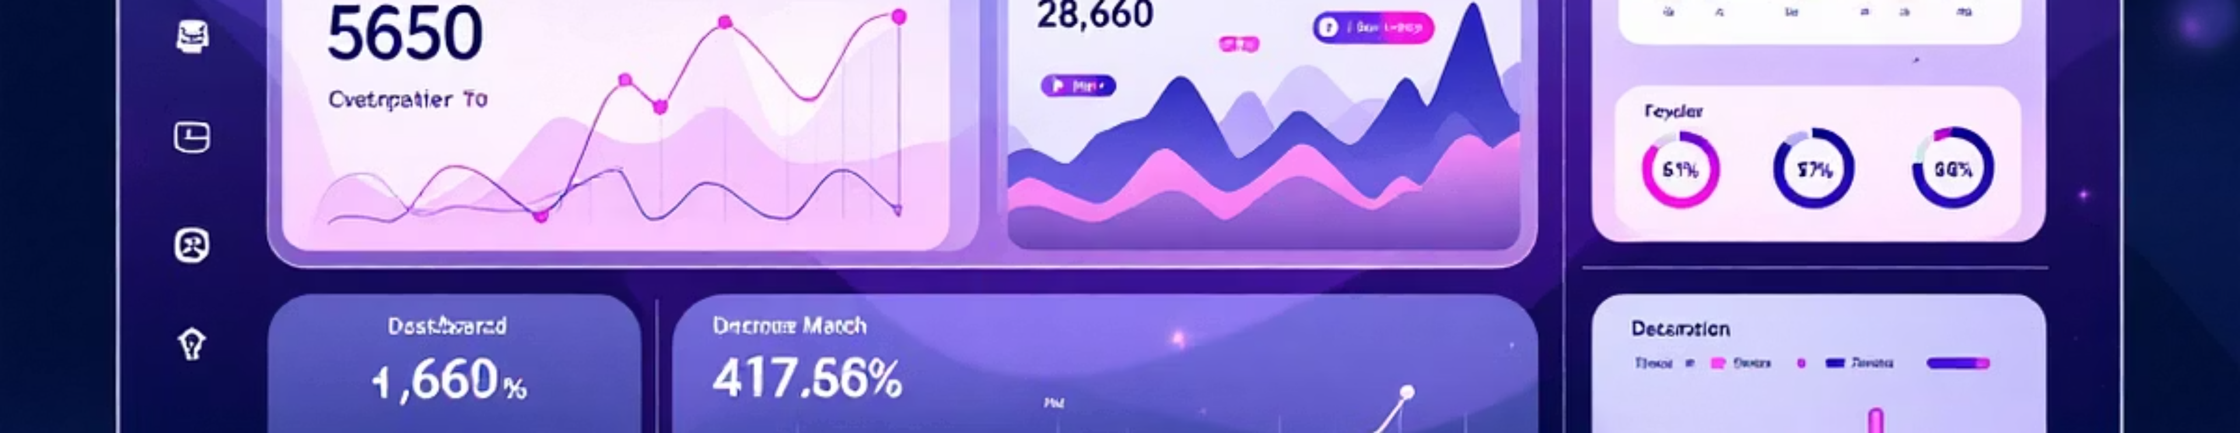
Project Overview
Data Foundation
Core Objective
Strategic Value
168 patient records with 18 clinical and operational attributes
Develop interactive Power BI dashboard revealing admission trends, demographics, and clinical patterns
Enable data-driven decision-making for hospital administrators and clinical teams

Slide 3

Data Architecture & Methodology
Dashboard Development
Data Transformation
Interactive Power BI visualisations with DAX measures, KPI cards, and cross-filtered slicers for dynamic exploration
Data Cleaning
Power Query Editor refines datasets, calculates length of stay, establishes date hierarchies across patient journeys
Python and Pandas to standardise formats, handle missing values, and calculate derived metrics including patient age from anonymised records

Slide 4

Dataset Composition
Primary Dataset
Medication Dataset
168 rows, 18 columns covering complete patient journey
100 rows, 7 columns with pharmaceutical details
Patient identifiers, demographics, clinical conditions, admission protocols, billing, satisfaction metrics, and follow-up care
Medication effectiveness, side effects, dosage protocols, treatment duration, associated costs, and prescribing physicians

Slide 5
Data Quality Assessment
100%
93%
82%
Core Fields Complete
Patient Satisfaction
Follow-up Data
Patient ID, Age, Gender, Medical Condition, Admission and Discharge dates fully populated
12 missing values require imputation or exclusion from satisfaction analysis
30 missing follow-up dates suggest incomplete discharge protocols requiring review

Slide 6
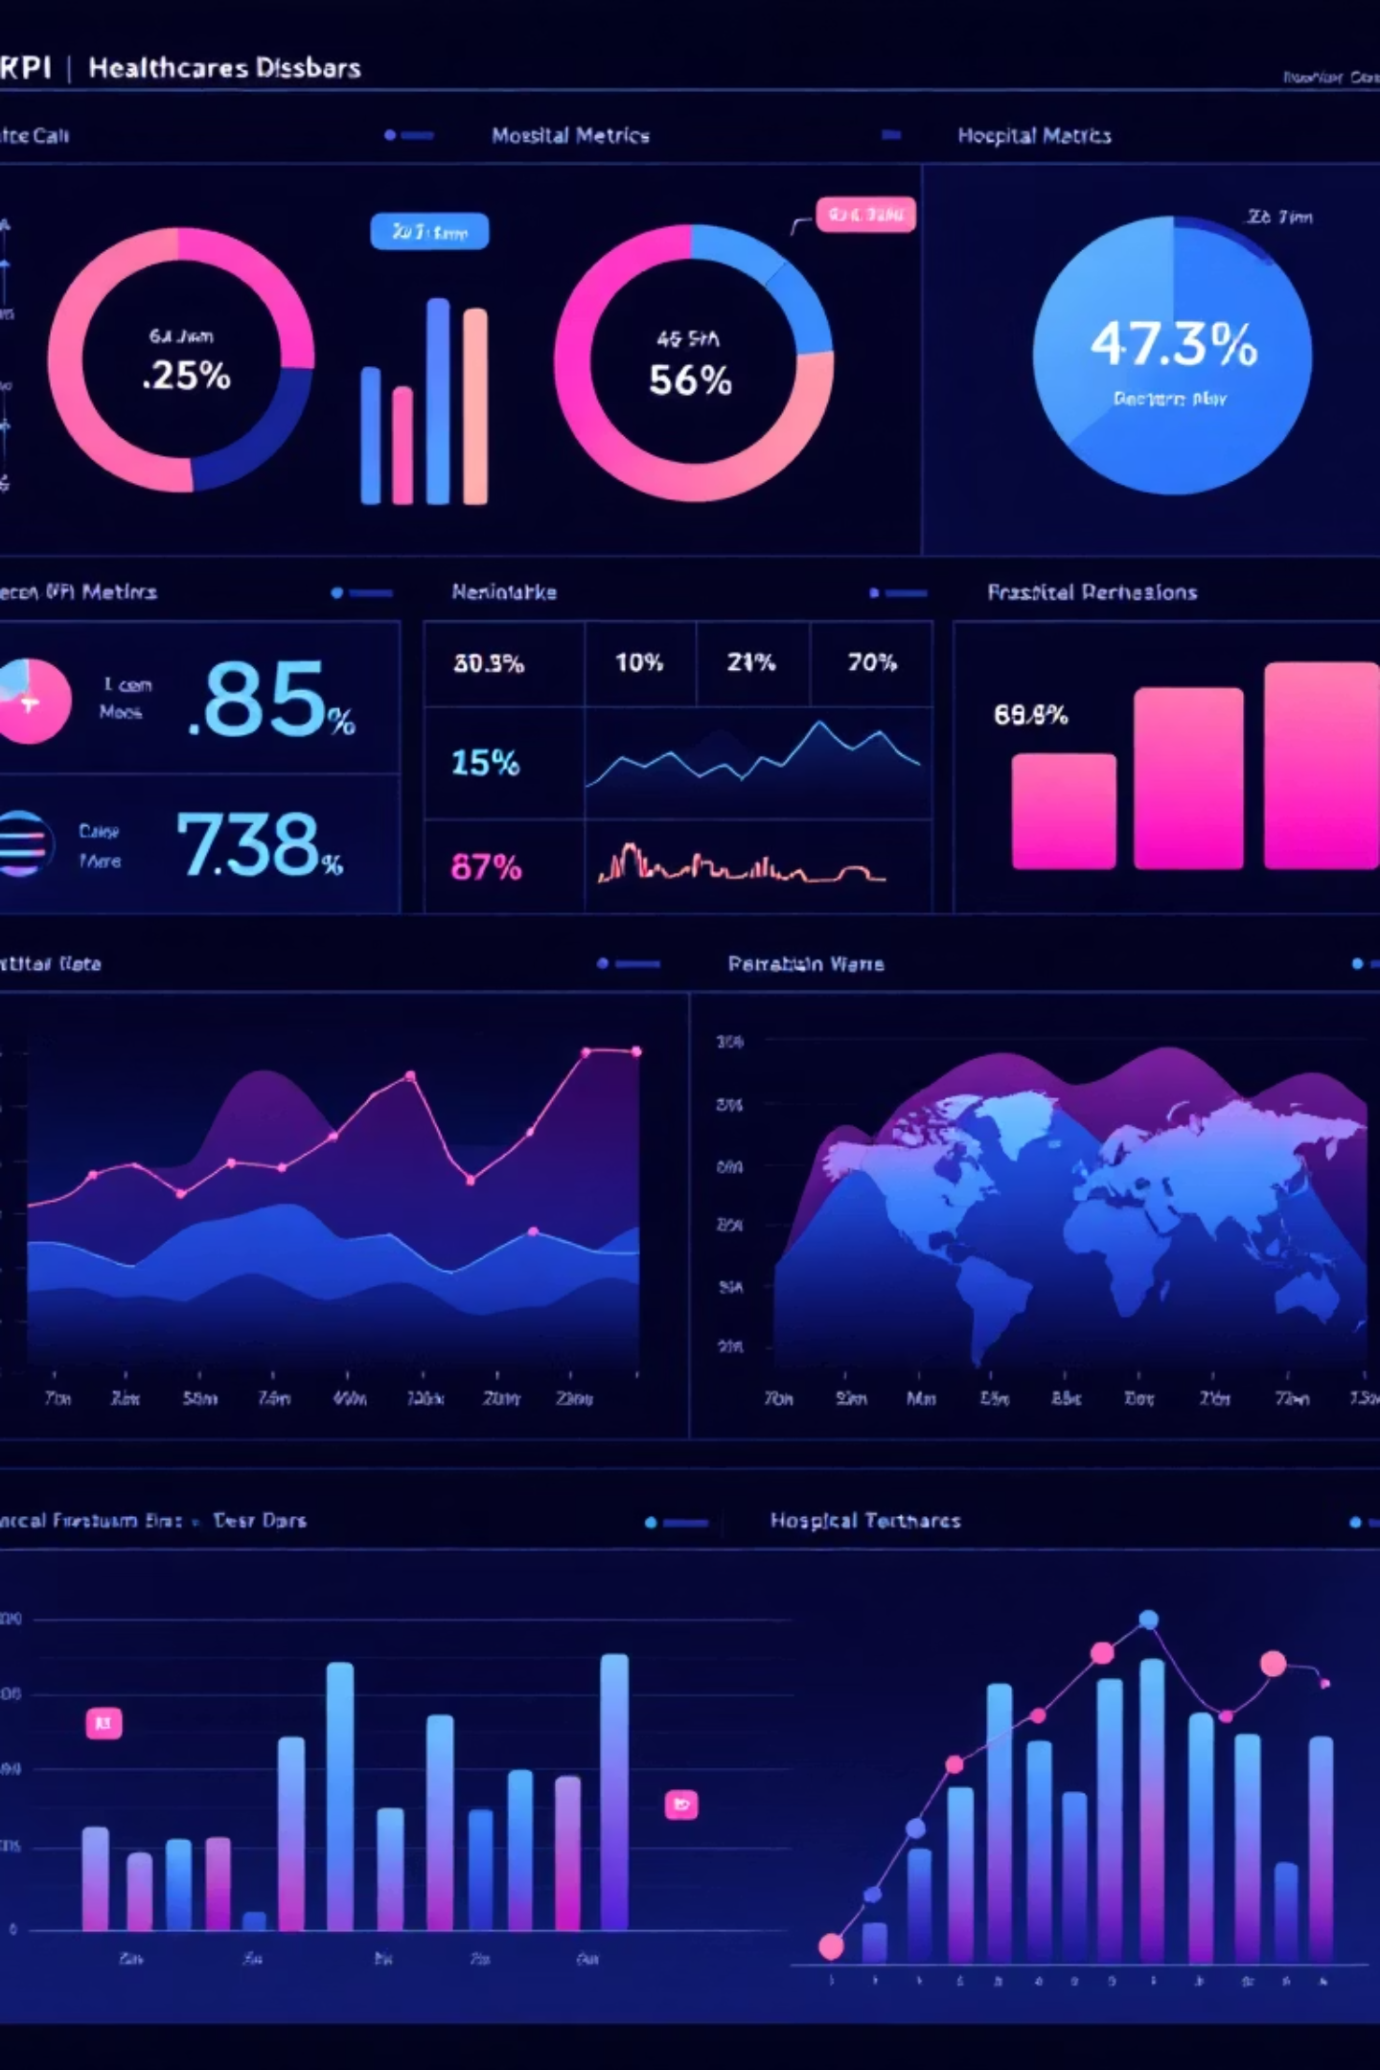
Key Performance Indicators
168
$12K
4.2
Total Patients
Average Billing
Satisfaction Score
Complete patient cohort in dataset
Mean cost per patient admission
Patient experience rating out of 5.0

Slide 7
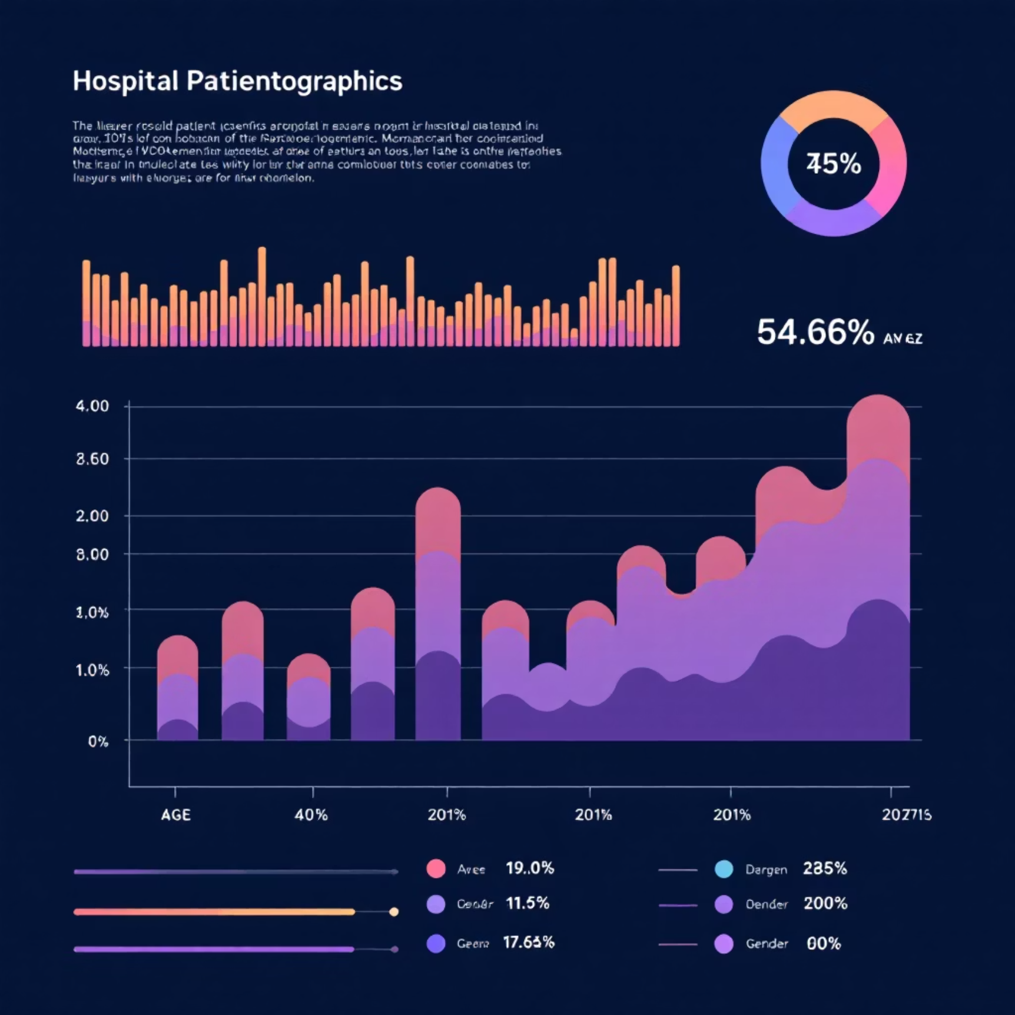

Demographic & Clinical Insights
Patient Distribution
Admission Patterns
Gender ratios and age group segmentation reveal patient population composition
Emergency versus elective admissions, predominant medical conditions driving hospital utilisation

Slide 8





Geographic & Operational Analysis
Dynamic Filtering
Hospital Locations
Slicers enable targeted analysis by gender, condition, and admission type
Geospatial distribution of patient volume across facilities
Length of Stay
Wait Times
Average patient duration quantifies bed utilisation and operational efficiency
Patient wait time metrics identify bottlenecks in admission processes

Slide 9

Dashboard Interactivity & Functionality
Multi-Dimensional Slicing
1
Filter visualisations across demographic, clinical, and operational dimensions for granular patient cohort analysis
Integrated Charting
2
Pie charts for gender distribution, bar charts for age groups and conditions, maps for geographic analysis
Real-Time Insights
3
DAX-powered measures provide dynamic calculations and cross-filtered dashboards for immediate clinical intelligence

Slide 10





Implementation & Clinical Impact
Data Foundation
Dashboard Deployment
Strategic Decisions
Standardised, cleaned records across all clinical systems
Interactive Power BI platform operational for administrators and analysts
Evidence-based insights drive resource allocation and clinical pathways
This comprehensive analysis enables hospital leadership to optimise patient flow, reduce wait times, improve satisfaction scores, and enhance operational efficiency through data-driven decision-making and continuous performance monitoring.

